Slide 1
Ethereum Smart Contract Security with AI Vulnerability Scanner
Team Members:
1. Sravya Kaitha
2. Chaithra Angadi

Slide 2
OBJECTIVES
1. Develop a comprehensive machine learning framework, ESCORT, for identifying vulnerabilities in Ethereum smart contracts.
2. Enable lightweight transfer learning within ESCORT to enhance adaptability, addressing previously unknown security flaws for improved extensibility.
3. Implement multi-class vulnerability detection capabilities within ESCORT to provide a more nuanced understanding of potential risks.
4. Enhance the generality of the vulnerability detection framework, ensuring it can adapt to various types of security threats in Ethereum smart contracts.
5. Improve the overall security of financial transactions and decentralized applications by leveraging ESCORT to identify and mitigate vulnerabilities in smart contracts.

Slide 3
Tools and Techniques
Python
Jupyter Notebook.
ML Techniques.
DL Techniques.
Colab, GPUs

Slide 4
Deliverables
ESCORT Framework Implementation
Feature Extraction Modules
Multi-Output Architecture
Contract Scraper Toolchain
Documentation and Evaluation

Slide 5
Methodology
1. AST Construction.
- Start by building an abstract syntax tree (AST) from the smart contracts under analysis.
2. Malicious Source Code Gathering.
- Collect ASTs of malicious source codes representing smart contracts with fundamental vulnerabilities.
3. Feature Vector Generation.
- Identify shared child nodes between ASTs (A and B) and transform them into vectors to create a feature vector.
4.Labeling with Analysis Tools.
- Utilize analysis tools like Slither and Ethainter to label the smart vectors generated in the previous step.

Slide 6
5. Model Training:
- Train the model using various machine learning classification algorithms, including SVM, ClassifierChain, and ANN, in the final phase of the process
6. Model Hyperparameter tuning
-We have tuned the hyperparameters of ANN using grid search cv
7. Model Testing
-we have used metric called ROC

Slide 7
Existing System:
1. Oyente detects contract vulnerabilities through symbolic execution, exploring all executable paths with time-consuming iteration of loop bodies.
2. Securify identifies vulnerabilities, compliance, and violations by extracting precise semantic facts from contract dependency graphs, requiring time for graph construction and pattern matching.
3. Oyente relies on symbol execution for vulnerability detection, while Securify employs symbolic analysis of dependency graphs to match compliance and violation patterns, with a longer processing time.

Slide 8
Proposed System:
1. Contract Ward efficiently detects vulnerabilities in smart contracts by simplifying code to opcodes, reducing the number of features through n-gram (n = 2) extraction.
2. It employs a supervised machine learning algorithm to train an objective function, capturing the mapping relationships between feature space and sample labels.
3. Contract Ward iteratively updates parameters during training, refining the objective function through progressive iterations.
4. The trained parameters enable Contract Ward to directly predict the vulnerability status and types in new samples during the prediction process.
5. Through this approach, Contract Ward streamlines the detection of smart contract vulnerabilities by simplifying input data and utilizing machine learning for accurate predictions.

Slide 9
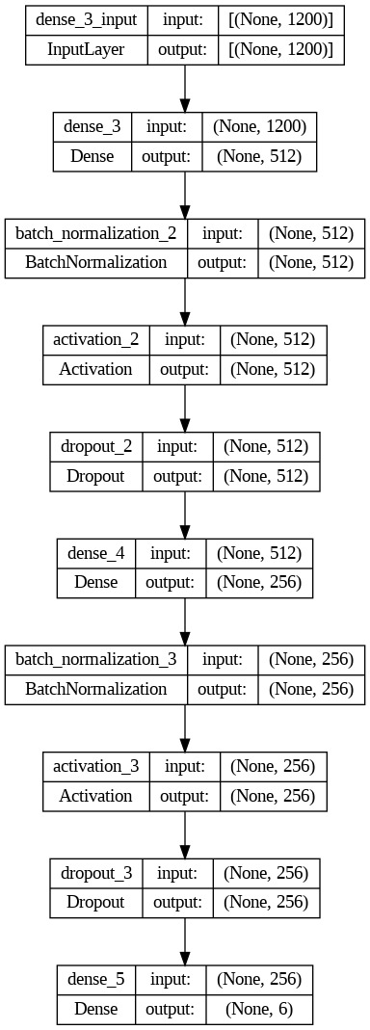
ARCHITECTURE

Slide 10
SMART CONTRACTS AND VULNERABILITIES
Coined by Nick Szabo in the 1990s, a smart contract is a self-executing protocol embodying buyer-seller terms in code. Initially theoretical due to a lack of trustworthy execution, blockchain technology since 2009 provides a secure environment. Vulnerabilities in smart contracts refer to weaknesses in the code that may be exploited, posing risks to the integrity and security of the automated agreements within the decentralized blockchain network.

Slide 11
Security Vulnerabilities in Smart Contracts
Reentrancy Vulnerability:
-Allows an external contract to repeatedly call back into a function before the current execution is complete, potentially manipulating the contract's state.
2.Integer Overflow/Underflow:
- Arises from improper handling of numeric values, leading to unexpected behavior when values exceed the maximum or minimum limits of the data type.
3.Unprotected Ether Withdrawal:
- Insecure withdrawal functions may permit unauthorized access to funds stored in the contract, posing a risk to financial resources.

Slide 12
4.Unchecked External Calls:
- Fails to validate responses from external contracts or oracles, exposing the smart contract to manipulation and unauthorized data alterations.
5.Code Injection:
- Results from poor input validation or reliance on unvalidated external data, potentially allowing attackers to inject malicious code into the contract.
6.Denial-of-Service (DoS) Vulnerability:
-Smart contracts lacking resistance to overwhelming requests or computations may be susceptible to disruptions, causing resource exhaustion.

Slide 13
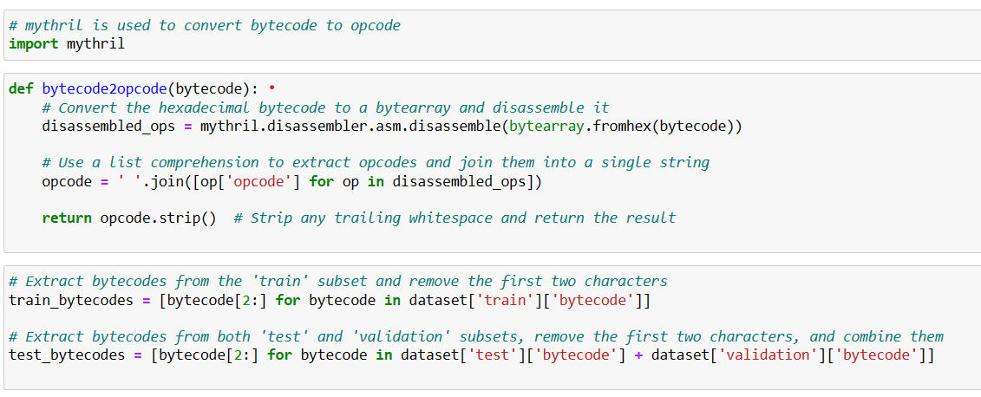
Bytecode to Opcode Conversion

Slide 14
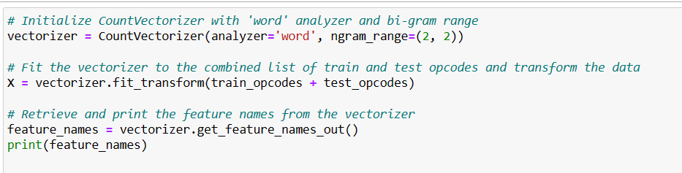
Bigram Feature Extraction

Slide 15
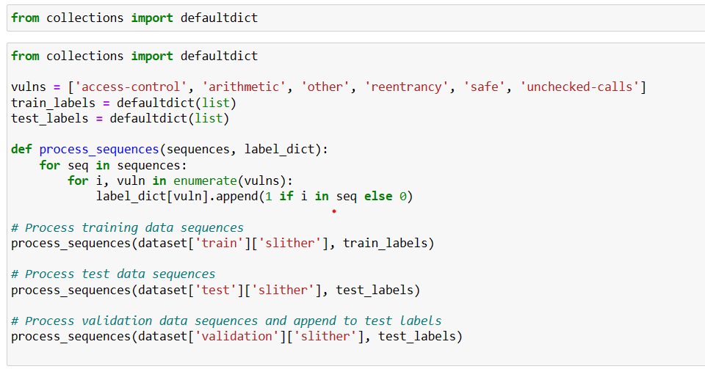
Feature Extraction and Labeling for Smart Contract Analysis

Slide 16
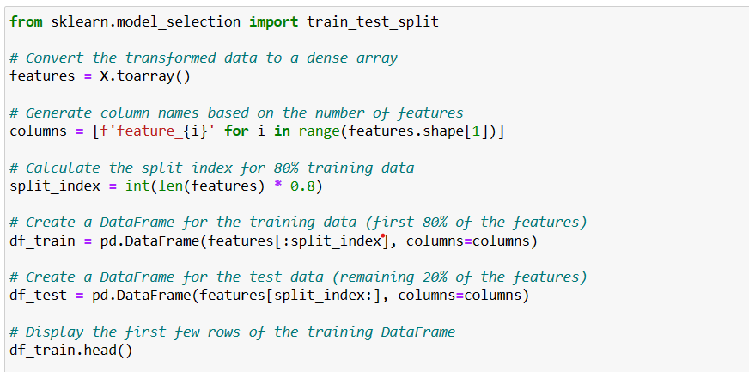
Building Training Data and Test Data

Slide 17
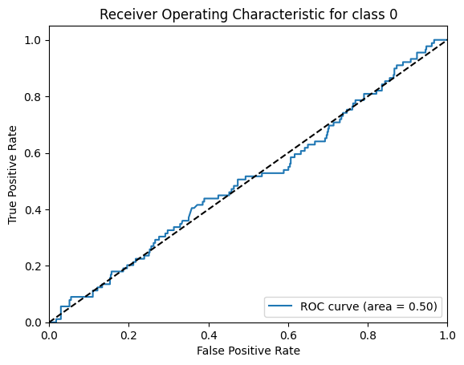
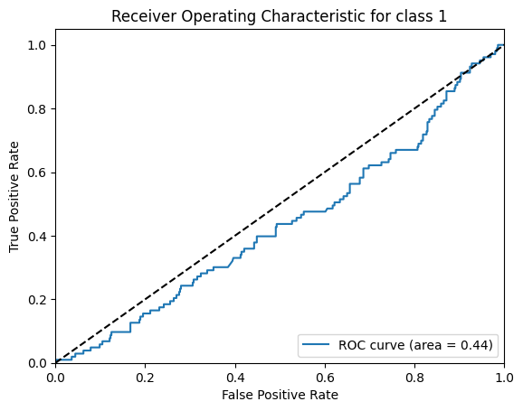
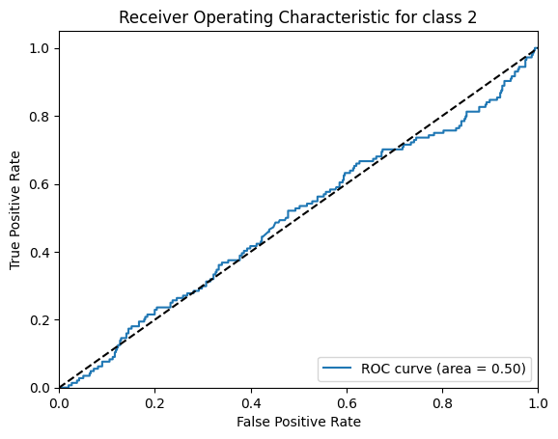
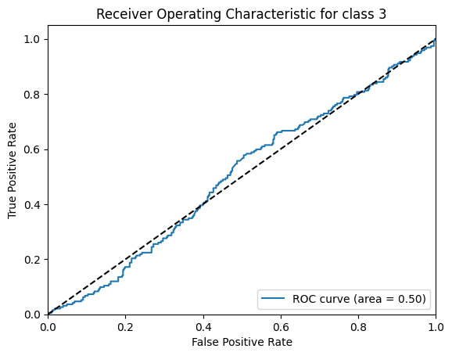
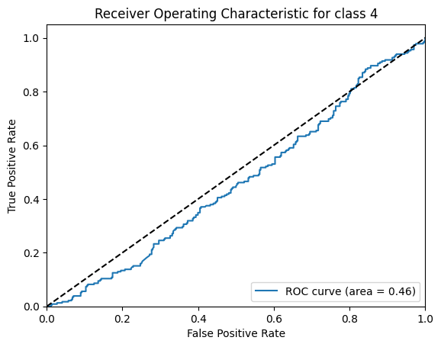
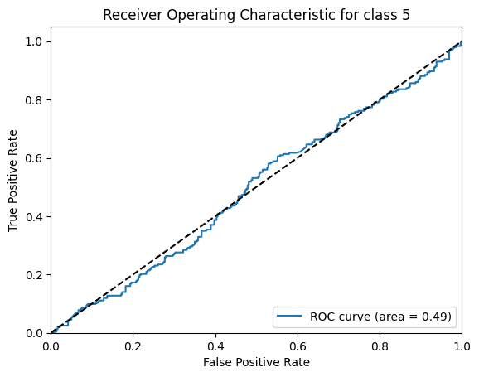
SVM AND ROC CURVES

Slide 18
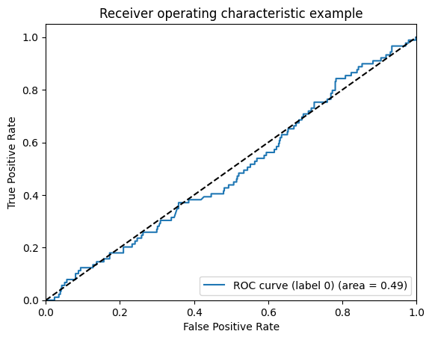
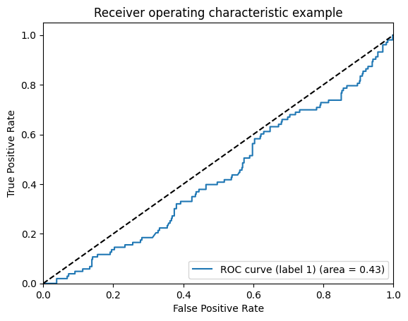
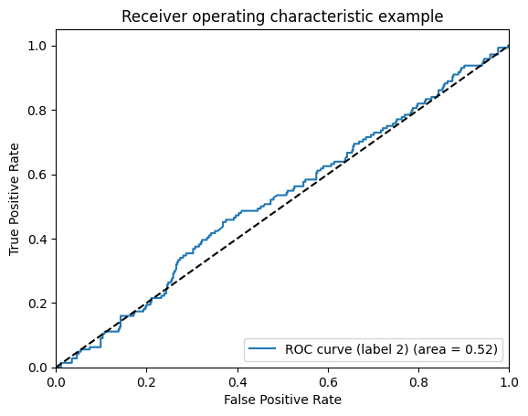
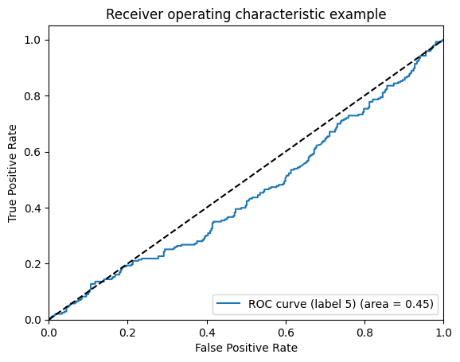
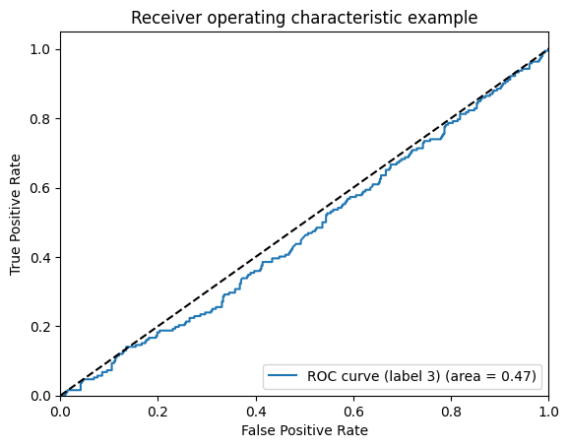
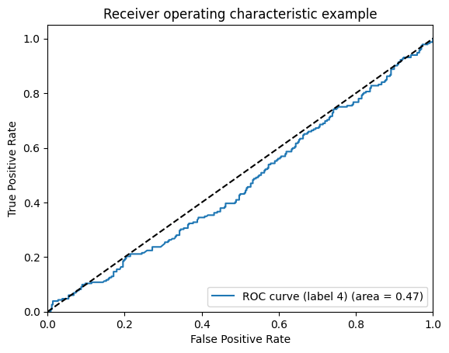
ANN AND ROC

Slide 19
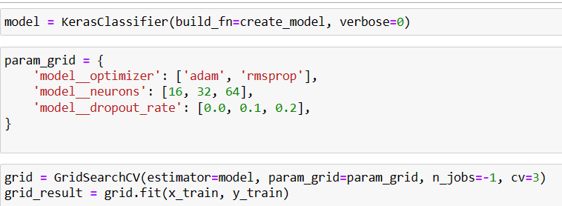
Hyperparameter Tuning
Hyperparameter tuning is the process of optimizing the configuration settings external to a machine learning model to enhance its performance. This involves systematically adjusting parameters to find the optimal combination for improved accuracy and generalization.

Slide 20


